Slide 1


Machine Learning
8/17/2018

Slide 2
Machine learning
Objectives
Methodology and algorithms used
Results and opportunities

Slide 3
1 . Objectives
Automatic generation of test cases
Analysis of requirements and design’s text
Text classification

Slide 4
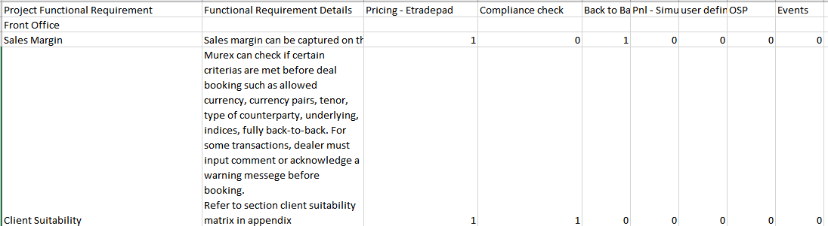

Text classification
Data : Set of text with know categories
Problem : Set of texts with unknown categories

Slide 5
2. Methodology and algorithms
Natural language processing, for data transformation
Supervised algorithm of Machine Learning
Neural Network (Most common, easy to adapt to various problems … )

Slide 6
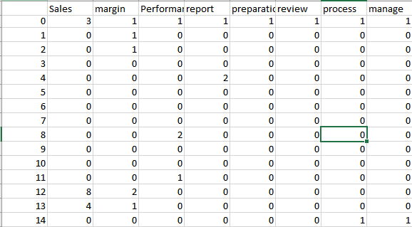
Natural language processing
Very important in ML : Data transformation (Here , from texts to numerical data)
Data characteristics: relevant, accurate, reasonable size …
e.G : matrix of word frequencies

Slide 7
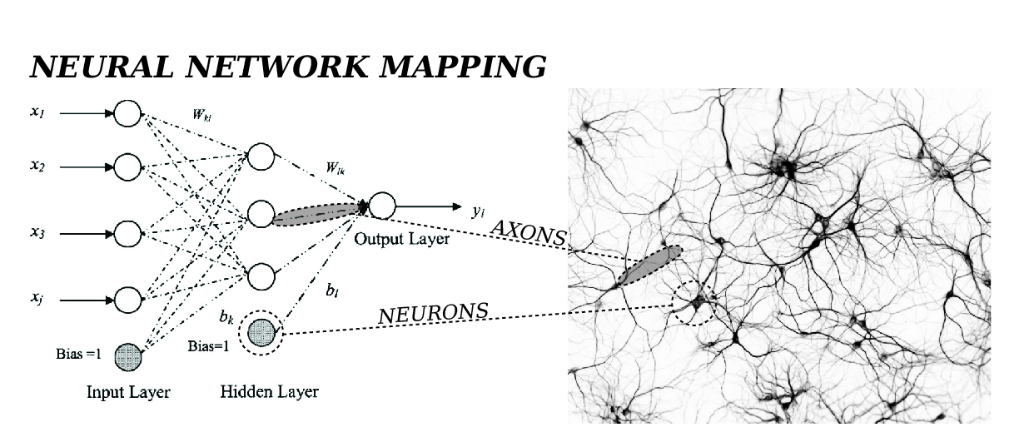
Neural network
You train your neurons, again and again, to learn to do a task by imitating something you saw.

Slide 8
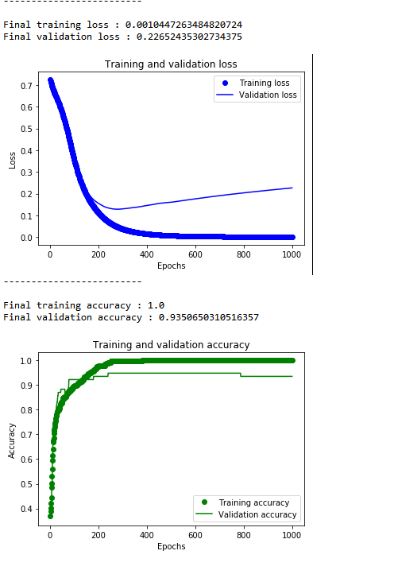
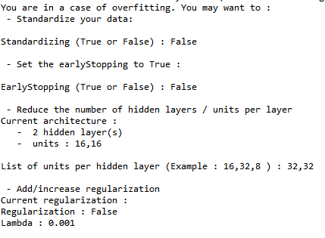
Results
End-to-end tool for you to use : from data transformation to classification
Guides you towards the most adapted NN architecture for your problem
Can apply to any classification problem (supervised)

Slide 9



Opportunities
Famous applications of NN: Word embedding

